Slide 1

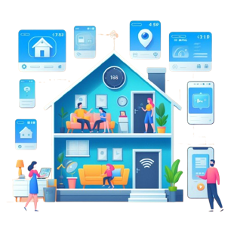
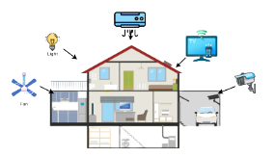


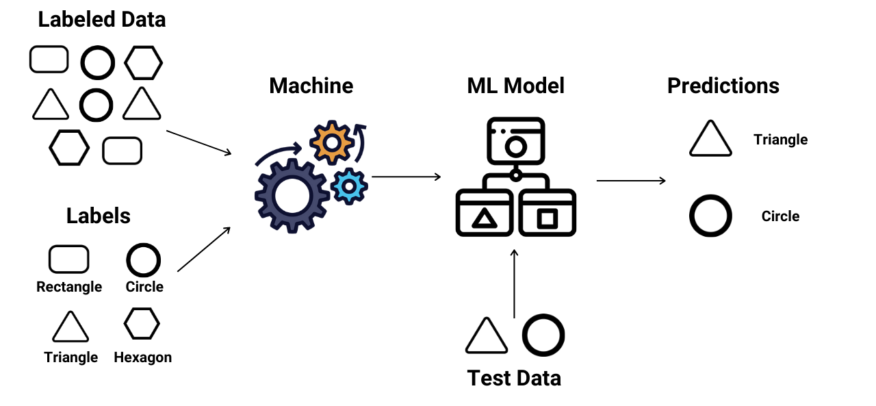
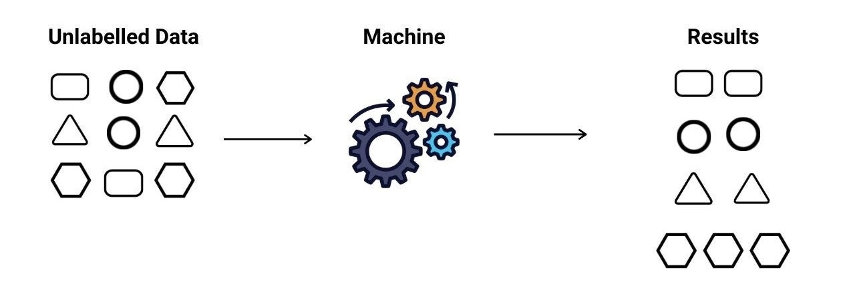
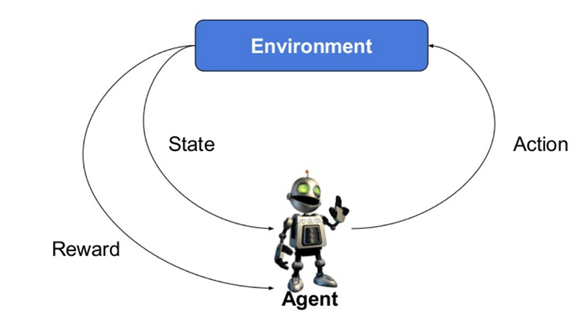
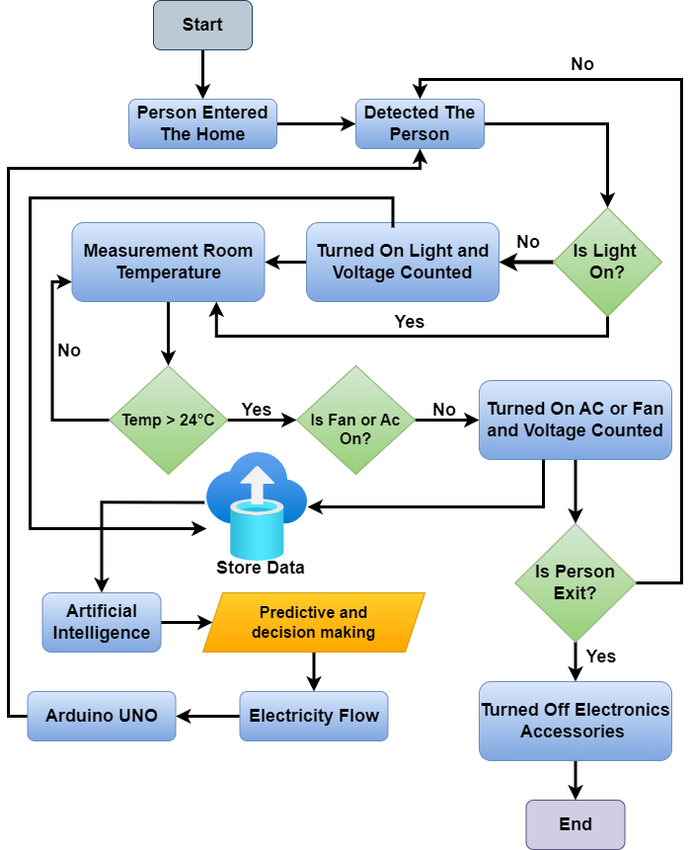
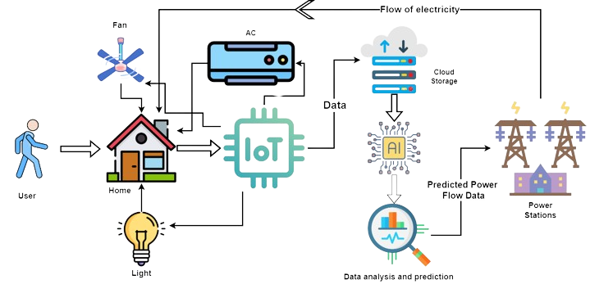
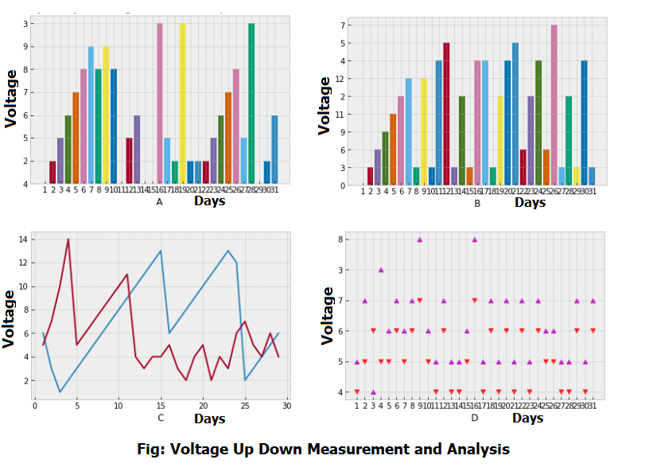
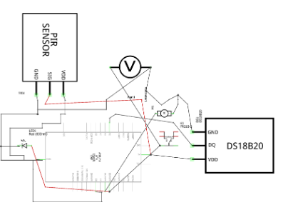
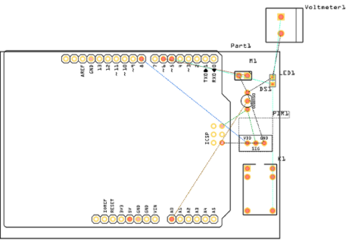
Smart Sage: IoT-Driven Home Automation Framework with Predictive Machine Learning
Rayhan Al Shorif and Khondaker Abdullah Al Mamun
Overview
Introduction
In the modern generation, the use of automation or AI has become an integral part of our lives. As a result, today it affects various aspects such as transportation and communication, communication, even starting from the rising of the sun every morning and household chores till sunset. Smart home apps are changing the standard of living of people and helping people to do any task very easily, considering this is our endeavor. Nowadays people are more and more attracted towards automation so this paper considers basically how to automate a home or office appliance using machine learning and Arduino Uno. Also, it measures the voltage of the electricity from them to
give an idea or framework of what the future electricity demand might be for them.
The home self-regulation concept is growing in popularity for reducing human effort including errors and thus increasing efficiency. We can manage remote home appliances help of Home self-regulation. Over and above that, the home self-regulation system can also integrate other ardors like alarms, emergency systems, security, etcetera.
Prediction With Machine Learning
Data Flow Diagram of the Proposed System
Methodology of This System
Result and Analysis
Our proposed framework offers invaluable assistance in automating the trac-
king and control of the smart home environment. Leveraging a reinforcement
learning algorithm, our system efficiently processes information to manage
home equipment, enabling informed decisions for optimal functionality.
Implementing this method yields successful identification of home appliance
usage and monitoring data with precision.
Schematic and PCB of Proposed system
Conclusion
Our project emphasizes low-power utilization via various sensors to augment smart home accuracy and efficiency. By effectively managing home devices, we optimize time and energy consumption, particularly in comparison to standalone or city-based stationary devices. Looking ahead, our system aims to integrate seamlessly with human activities, such as recognizing individuals entering the house, providing personalized interactions, and synchronizing household devices autonomously. This holistic approach promises to streamline home management effortlessly.

